Slide 1

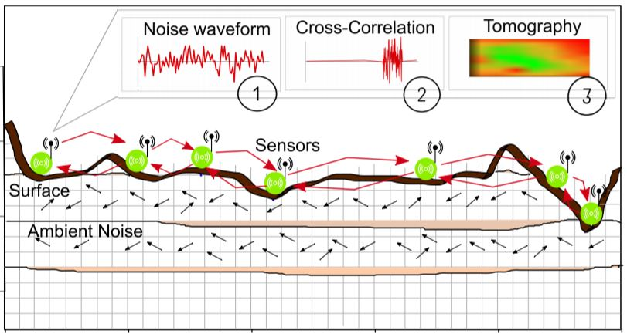
Data Processing for Ambient Noise Tomography
Shiv Mangal Gupta
16je002032

Slide 2
Contents
Introduction to ANT
Workflow for ANT
Data Processing Steps/Workflow for ANT
Conclusion and Results
Future Work

Slide 3
Introduction to Ambient Noise Tomography
Imaging of Earth subsurface using noise .
The method involves extraction of empirical Green’s function from the background ambient vibrations of the Earth, followed by computation of group or phase velocity and tomographic imaging in order to extract information about crustal and uppermost mantle depths
Particularly useful in aseismic areas; e.g., continental interiors.
For temporary deployments -- do not have to wait for earthquakes to occur.

Slide 4
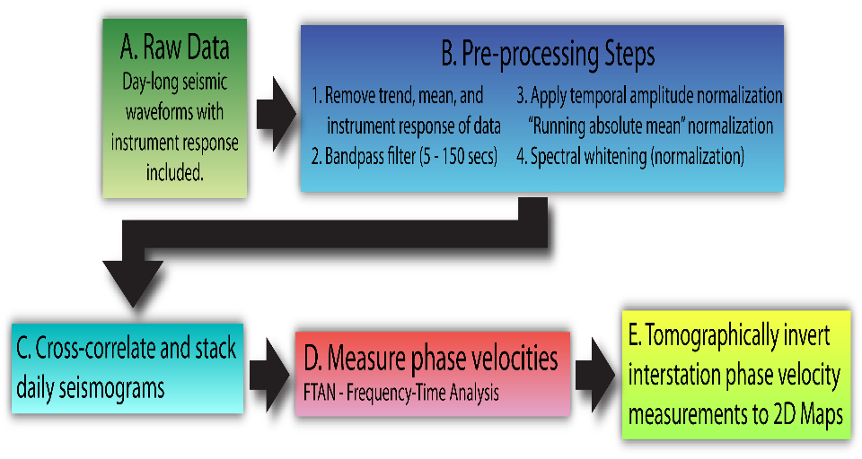
Work Flow for Ambient Noise Tomography Analysis
G. D. Bensen et al. 2007

Slide 5

Raw Data
What we need to obtain Green’s function from Ambient Noise Tomography:
Continuously recorded seismic waveform data
Contemporaneously operating stations
Correct (or common) instrument responses
Green’s Function (Earth’s response)
Instrument Response
Wavelet

Slide 6
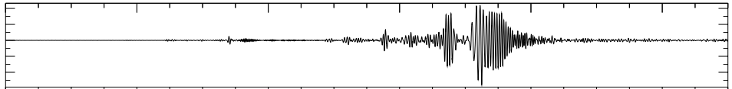
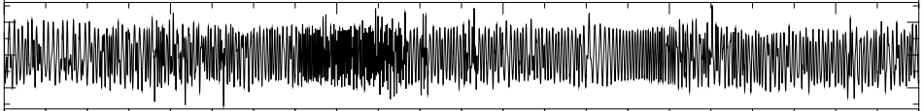
Processing Data Temporal normalization
After trend, and instrument responses removed, we normalize amplitudes in the waveforms.
Down-weights large amplitude signals that can dominate waveform which may leads to poor cross-correlations.
Good for removing earthquake signals.
Raw Data
After temporal normalization (running absolute mean method)

Slide 7
Processing Data Temporal normalization
Considered five different methods of Temporal Normalisation
One-bit normalization
Clipping Threshold normal to the RMS amplitude of the signal
Automated event detection
Running –absolute mean normalization
Water level normalization

Slide 8
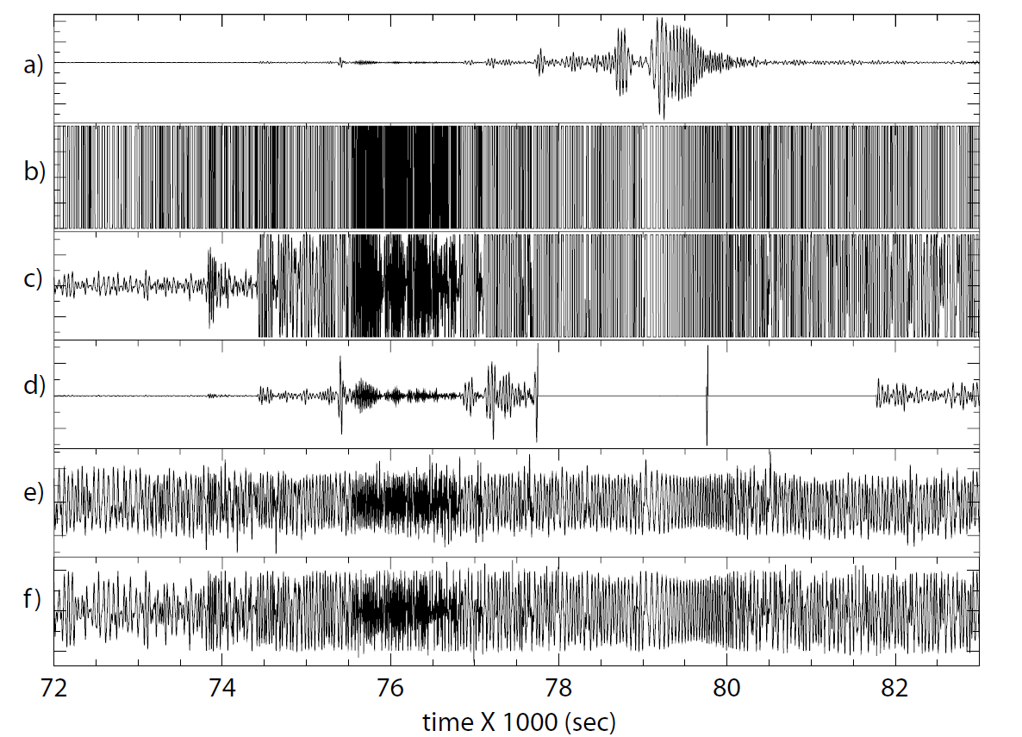
Processing Data Temporal normalization
Considered five different methods of Temporal Normalisation
One-bit normalization
Clipping Threshold normal to the RMS amplitude of the signal
Automated event detection
Running –absolute mean normalization
Water level normalization

Slide 9
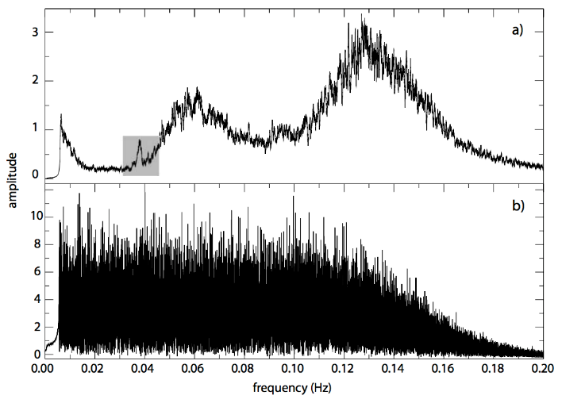
Processing Data Spectral Normalization/Whitening
It broadens the band of the ambient noise signal in cross-correlation.
Combats degradation caused by present monochromatic sources.
Removes spectral power biases from micro-seismic energy and other consistent noise sources.
Before spectral whitening
After spectral whitening

Slide 10
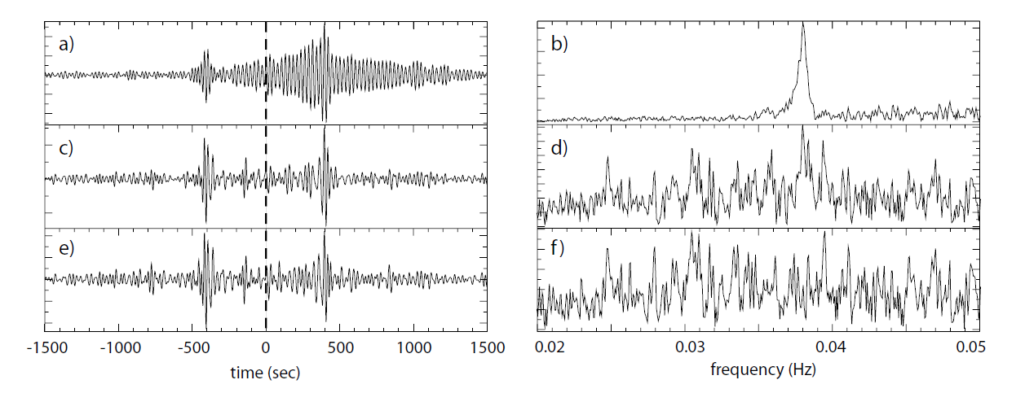
Processing Data Spectral Normalization/Whitening
In given Data there was an effect of the 26 s microseism on cross-correlations and attempts to remove it.
(a) Twelve-month cross-correlation between data from two stations. The broad, nearly monochromatic 26 signal at positive lag dominates the waveform. (b) Amplitude spectrum of the cross-correlation in (a) showing the spectral peak at about 26 s period. (c) Cross-correlation between data from the same two stations that have been spectrally whitened prior to cross-correlation. (d) Amplitude spectrum of the cross-correlation in (c) showing that the 26 s spectral peak is largely missing. (e) Cross-correlation between the data that have been spectrally whitened prior to cross-correlation with a notch filter applied around 26 s period. (f) Amplitude spectrum of the cross-correlation in (e). Application of the notch filter changes the cross-correlation only minimally.

Slide 11
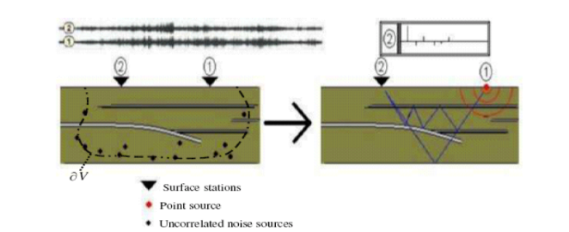
Data Processing Cross-Correlations and Stacking
Surface wave empirical Green functions (EGFs) can be determined from cross-correlations between long time sequences of ambient seismic noise observed at different stations.

Slide 12
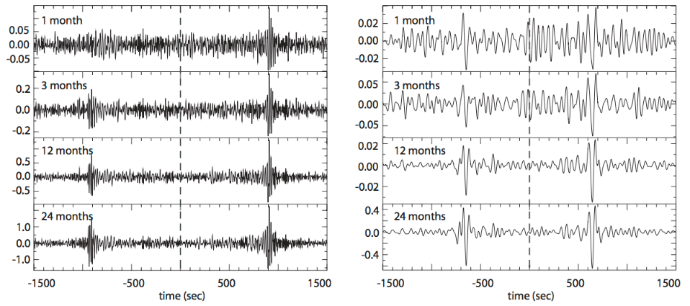
Data Processing Cross-Correlations and Stacking
In order to enhance the signal to noise ratio (SNR), stacking of available daily cross-correlation for each component and station pair is done.
(a) Cross-correlations at the specified time-series lengths for the station pair band-passed between 5 and 40 s period. (b) Same as (a), but for a passband between 40 and 100 s period.

Slide 13
Conclusion and Results
Result from Temporal normalization.
Result from Spectral normalization.
Since ANT does not depend on the location of impulsive sources such as earthquakes, rather only the location of the receivers, the resolution of ambient noise tomography in relatively aseismic regions can be greater than that achieved by local surface wave tomography using earthquakes.

Slide 14
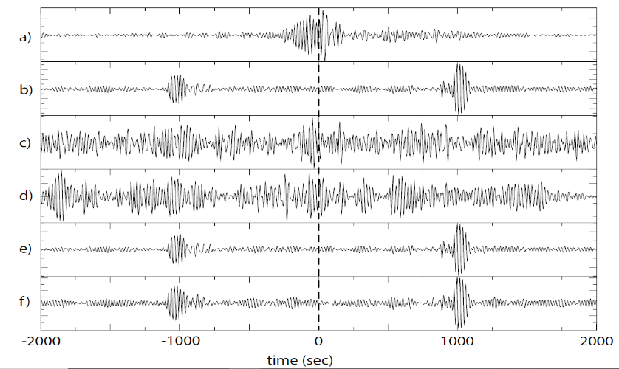
Conclusion and Results
Figure below presents examples of year-long cross-correlations, bandpass filtered between 20 s and 100 s period, using each of these methods of time-domain normalization.
The raw data (a), the clipped waveform method (c), and the automated event detection method (d) produce noisy cross-correlations in this period band.
The one-bit normalization (b), the running-absolute mean normalization (e), and the water-level normalization (f) methods produce relatively high SNR waveforms displaying signals that arrive at nearly the same time.

Slide 15
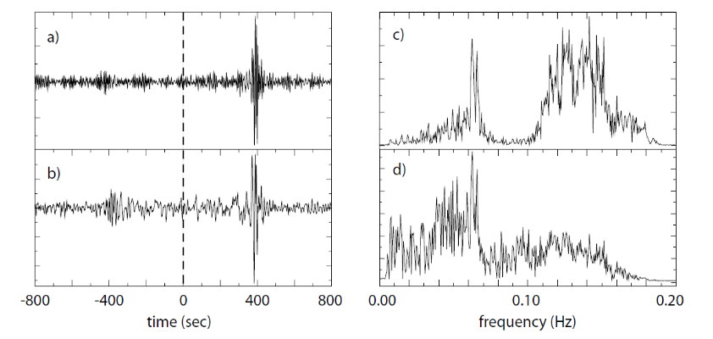
Conclusion and Results Result from Spectral normalization
(a) Cross-correlation without spectral whitening. (b) Cross-correlation with spectral whitening. (c) Amplitude spectrum of the unwhitened waveform in (a). The primary and secondary microseisms dominate the spectrum. (d) Amplitude spectrum of the pre-whitened waveform in (b).

Slide 16
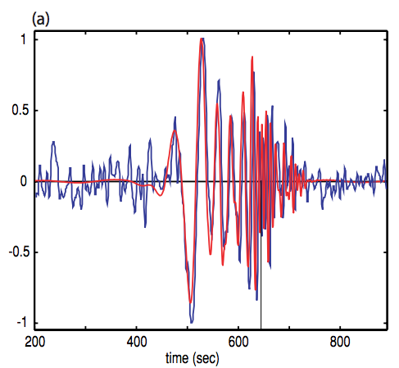
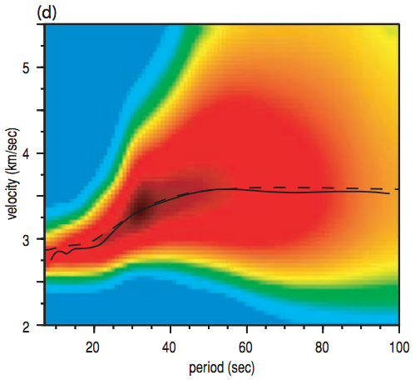
Future Work Dispersion measurement
Next stage of my work is to calculate the dispersions.
Useful property of surface wave is that they are dispersive: the longer period waves within a packet of surface wave energy have a longer wavelength and hence penetrate deeper into Earth. Since different frequencies are sensitive to properties at different depths, study of surface wave dispersion allows us to infer information about how seismic velocity varies with depth in the Earth
Interstation Dispersion Curves!

Slide 17
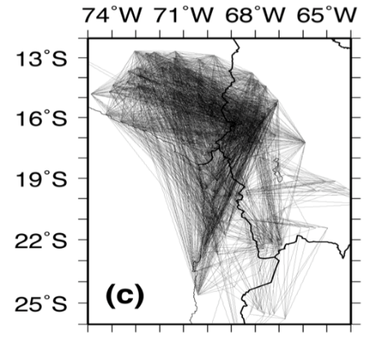
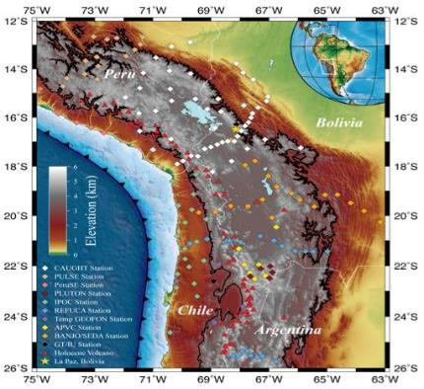
Future Work Tomographic Inversion
Inverting surface wave velocities at different periods, measured for many paths within a given region, to obtain models of the Earth’s velocity structure with depth .
Will be discussed later.

Slide 18
Thank You

